Slide 1



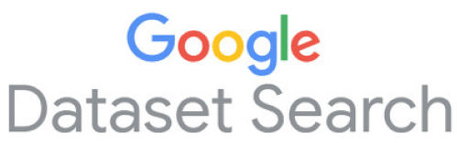
Croissant-RAI Standardized Machine-readable Dataset Documentation Format for Responsible AI
Dr Nitisha Jain
Informatics Department, King’s College London
September 17, 2024

Slide 2

Motivation
Data is a crucial element in emergent AI technologies, plays a central role in training and evaluating AI models.
Yet, quality and documentation remain significant challenges, leading to adverse downstream effects (e.g., potential biases) in applications*.
Working with data is time-consuming and painful
Wide variety of data formats
Lack of interoperability between tools
Difficulty of discovering and combining datasets
*Larrazabal et al. 2020. Gender imbalance in medical imaging datasets produces biased classifiers for computer-aided diagnosis.

Slide 3
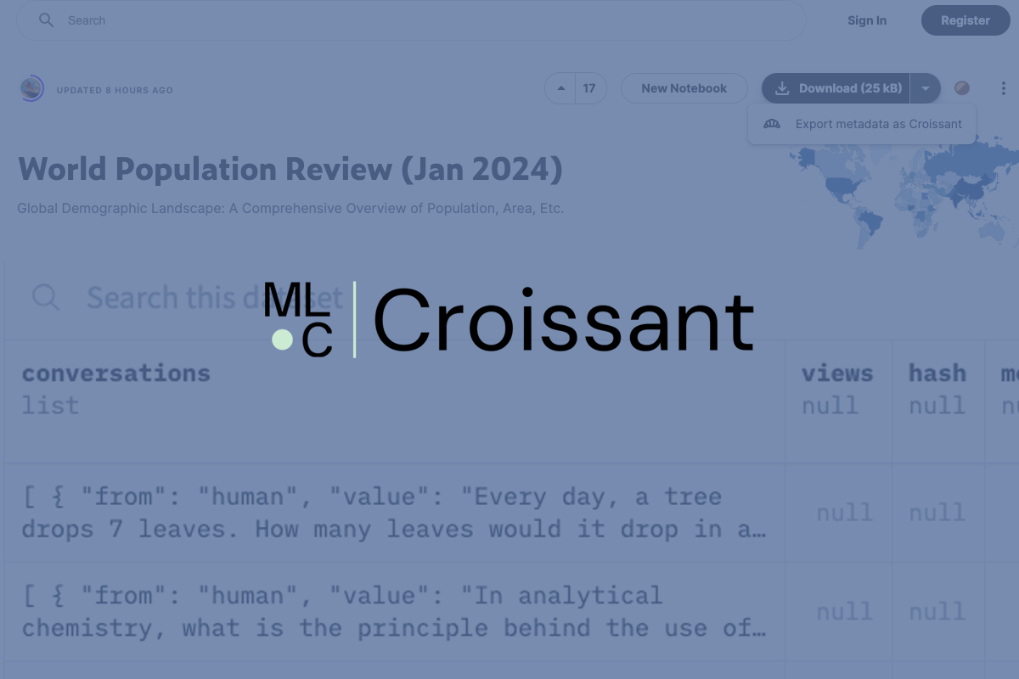
Metadata format to help standardize machine learning datasets.
Make datasets easily discoverable and usable across tools and platforms, no need for reformatting.
MLCommons Working Group
Industry support from HuggingFace, Google Dataset Search, Kaggle, OpenML, TFDS amongst others.
First release – March 6, 2024
Documentation, open-source library, visual editor.

Slide 4
Extension to schema.org, a machine-readable standard to describe structured data, used by over 40M datasets on Web.
Allows datasets to be discoverable through dataset search engines such as Google Dataset Search.
Adds metadata layer to represent dataset contents in standardized way, describing key attributes, properties.
Popular ML frameworks like TensorFlow, JAX and PyTorch can already load Croissant datasets via TensorFlow Datasets library.

Slide 5
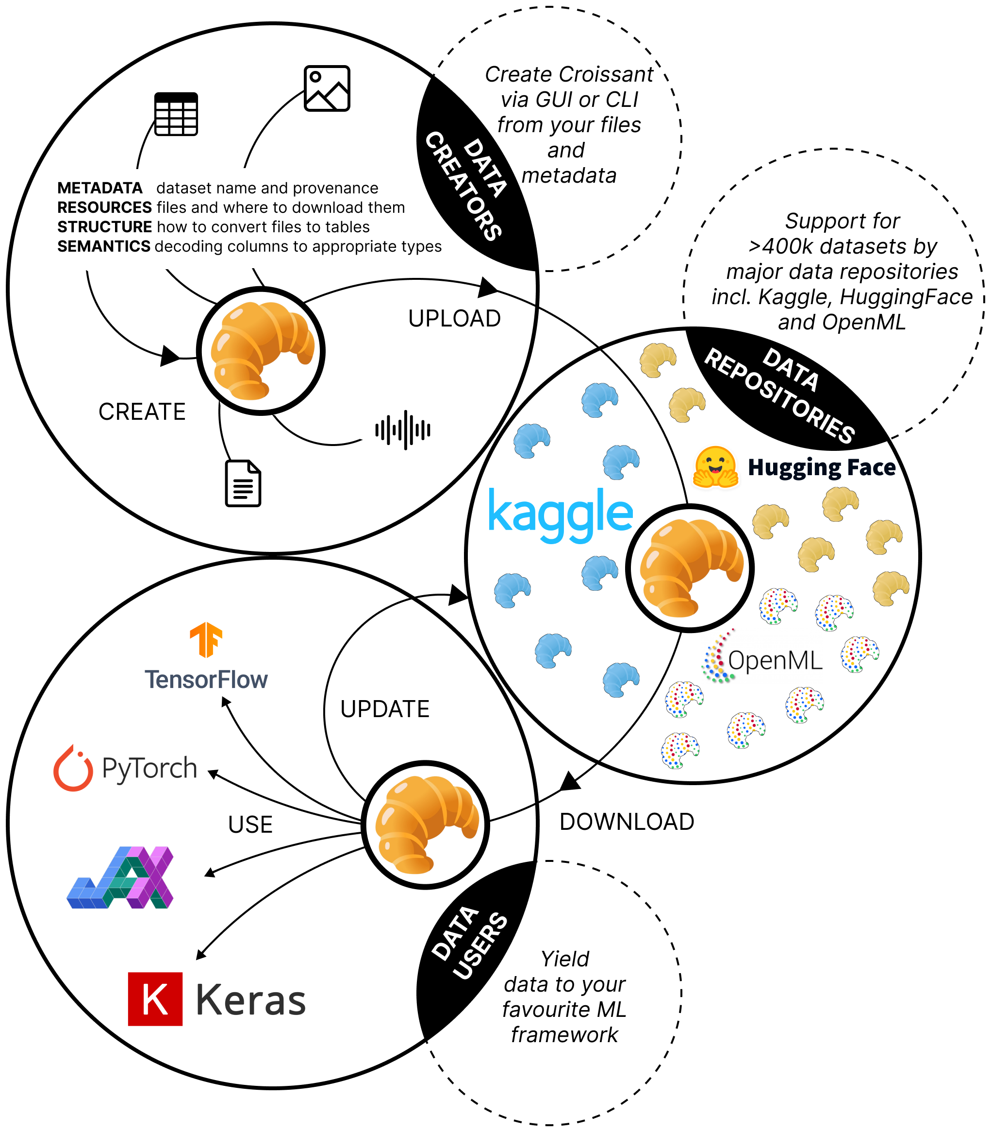
Croissant ML ready dataset format

Slide 6
Layers of Croissant
Dataset Metadata Layer
Contains relevant information such as name, description, and version.
Resource Layer
Describes the source data used in the dataset.
Structure Layer
Describes and organizes the structure of the resources.
Semantic Layer
Provides ML-specific data interpretation and semantics.

Slide 7
Operationalizing Responsible AI
Responsible AI (RAI) community has identified data documentation work as critical to the development of trustworthy AI systems*.
Limitations of current documentation proposals
Overlapping formats
Requirement of data documentation in natural language
Lack of standard structure
No integration with widely used tools and ML frameworks
Hence, do not support machine readability for automation.
*Datasheets for Datasets (Gebru et al. 2021), Data statements (Bender and Friedman 2018)

Slide 8
Croissant-RAI
Machine-readable metadata format to enhance the discoverability, interoperability, and trustworthiness of AI datasets.
Extends the Croissant metadata format.
Consists of set of attributes organized around RAI use cases such as AI safety and regulatory compliance.
Builds on and complements existing RAI dataset documentation proposals,
Aim to make publishing, discovering, and reusing existing RAI documentation easier.

Slide 9
Croissant-RAI Overview

Slide 10
Base Dataset documentation toolkits
HuggingFace Dataset Cards (https://huggingface.co/docs/hub/en/datasets-cards)
Kaggle metadata (https://github.com/Kaggle/kaggle-api/wiki/Dataset-Metadata)
Data Nutrition Labels (Holland et al. 2018)
Data Cards (Pushkarna, Zaldivar, and Kjartansson 2022)
Croissant (Akhtar et al. 2024)
Crowdworksheets (Diaz et al. 2022)
Fairness Datasets Ontology (https://fairnessdatasets.dei.unipd.it/schema/)
DescribeML (Giner-Miguelez, Gomez, and Cabot 2023)

Slide 11
Vocabulary Engineering Process for Croissant-RAI

Slide 12
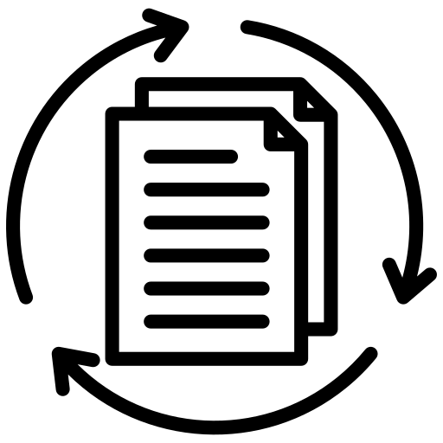




Use Cases for Croissant-RAI
Data Life Cycle
Data Labeling
Participa-tory Data
AI safety & fairness
Regulatory compliance

Slide 13
Data Life Cycle
cr:distribution cr:isLiveDataset
cr:citeAs
sc:creator sc:publisher
sc:datePublished
sc:dateCreated
sc:dateModified sc:version
sc:license sc:maintainer
Data Life Cycle
Data Labeling
Participa-tory Data
AI safety & fairness
Regulatory compliance
rai:dataLimitations
rai:dataCollection rai:useCases rai:dataReleaseMaintenance
rai:Data Processing
rai:Data Selection
rai:Data Inclusion/Exclusion
rai:Relationship to Source

Slide 14
Data Labeling
rai:annotationPlatform rai:annotatorDemographics rai:machineAnnotationTools
rai:Annotation Workforce Type
rai:Annotation Characteristic(s)
rai:Annotation Description(s)
rai:Annotation Guidelines
rai:Annotation Distribution(s)
Data Life Cycle
Data Labeling
Participa-tory Data
AI safety & fairness
Regulatory compliance
cr:distribution cr:isLiveDataset
cr:isAnnotationOf

Slide 15
Participatory Data
sc:participant sc:contributor
Data Life Cycle
Data Labeling
Participa-tory Data
AI safety & fairness
Regulatory compliance
rai:annotationPlatform rai:annotatorDemographics
rai:dataCollection
rai:dataCollectionTeam
rai:dataCollectionTeamDemographics
rai:dataCollectionPlatform
rai:targetCollectionDemographics

Slide 16
AI Safety and Fairness
rai:dataLimitations rai:dataBiases rai:useCases rai:personalSensitiveInformation
Data Life Cycle
Data Labeling
Participa-tory Data
AI safety & fairness
Regulatory compliance
sc:diversityPolicy
sc:ethicsPolicy sc:inLanguage

Slide 17
Regulatory Compliance
rai:personalSensitiveInformation rai:useCases rai:dataReleaseMaintenance
rai:dataImputationProtocol
rai:dataManipulationProtocol
rai:dataSharingAgreements rai:dataGovernanceProtocol
Data Life Cycle
Data Labeling
Participa-tory Data
AI safety & fairness
Regulatory compliance

Slide 18

Croissant is for
Creators and maintainers of ML datasets
Croissant makes datasets more widely available, across repositories and ML frameworks.
Designed to be modular and extensible for domain, modalities.
ML researchers and practitioners
Users of Croissant-enabled datasets have access to dataset documentation to understand the data and contribute to it.
Enable loading of data into ML platforms, no transformations needed.
RAI researchers and practitioners
Machine-readable summary of important attributes captured in a variety of data cards and similar approaches,
Portable and discoverable, promoting better documentation practices.
Policy makers
Standardized way to collect core information about datasets,
Facilitating the development of data-centric AI audit and assurance tools such as transparency indexes.

Slide 19
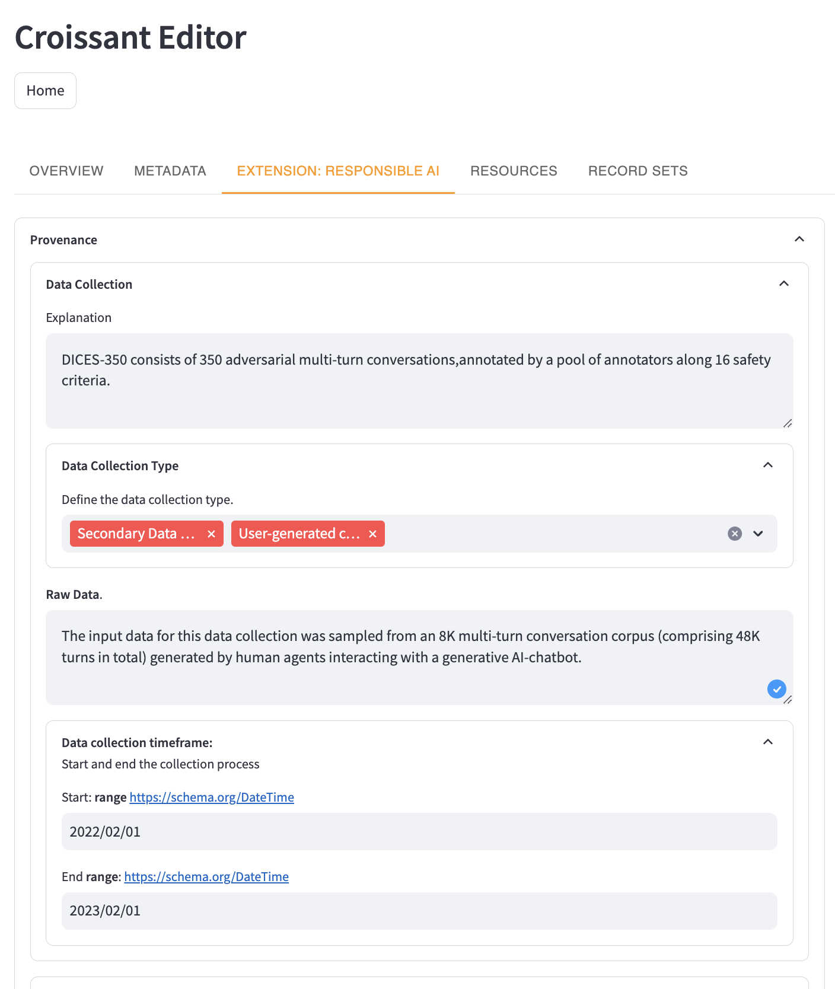
Tool Support

Slide 20
Ongoing efforts Next steps
Track the community’s uptake of the Croissant-RAI vocabulary, offering valuable insights into its real-world application.
Collaborate with both public and private partners, regulators and corporations, knowing the socio-technical dimensions of RAI practices.
Extensions for domains – geospatial datasets, life sciences, digital humanities.
Refine Use cases further, talk to stakeholders and potential adopters.
Look out for the next version ☺

Slide 21

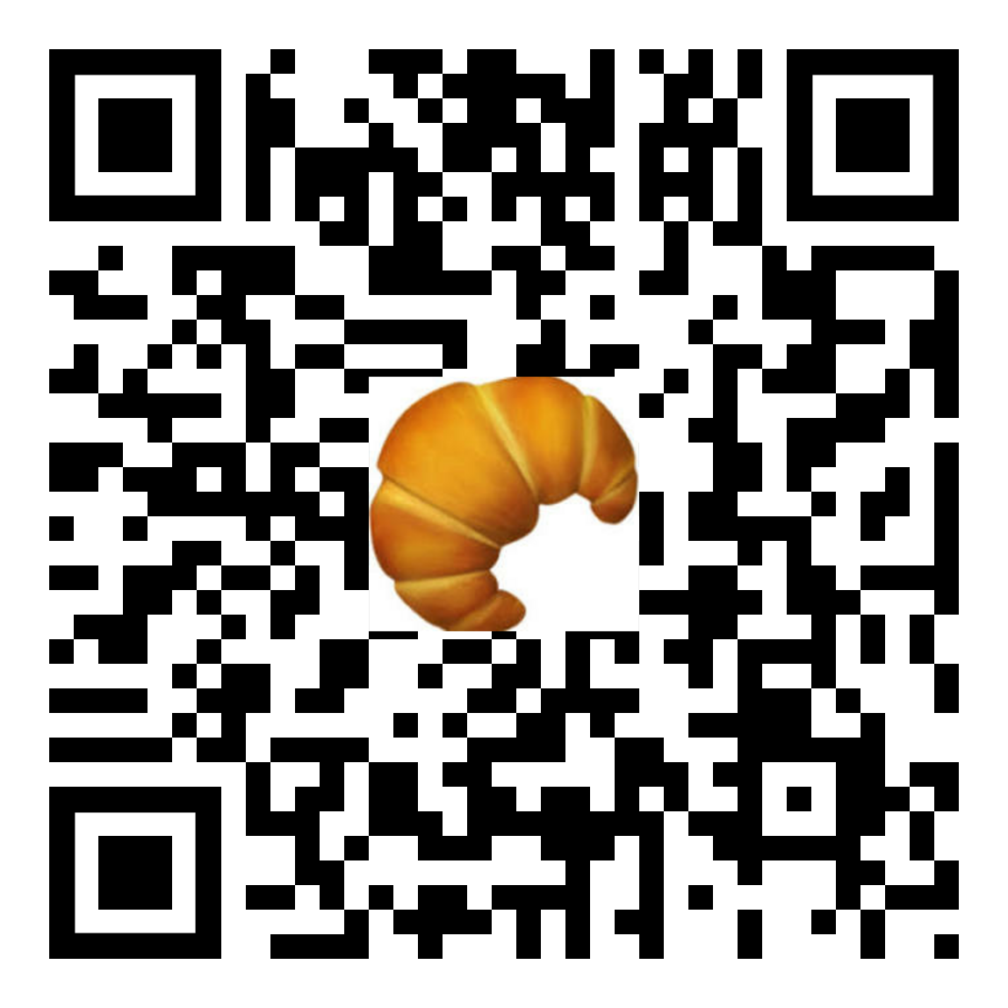
Thank you for your attention!
Contact us !
Join our working group !
Dr Nitisha Jain
Postdoctoral Researcher
Informatics Department
King’s College London (KCL)
https://www.linkedin.com/in/nitisha-jain/
https://nitishajain.github.io

Slide 23
Data Life Cycle
cr:distribution cr:isLiveDataset
cr:citeAs
sc:creator sc:publisher
sc:datePublished
sc:dateCreated
sc:dateModified sc:version
sc:license sc:maintainer
Data Life Cycle
Data Labeling
Participa-tory Data
AI safety & fairness
Regulatory compliance
rai:dataLimitations
rai:dataCollection rai:useCases rai:dataReleaseMaintenance
rai:Data Processing
rai:Data Selection
rai:Data Inclusion/Exclusion
rai:Relationship to Source

Slide 24
Data Labeling
rai:annotationPlatform rai:annotatorDemographics rai:machineAnnotationTools
rai:Annotation Workforce Type
rai:Annotation Characteristic(s)
rai:Annotation Description(s)
rai:Annotation Guidelines
rai:Annotation Distribution(s)
Data Life Cycle
Data Labeling
Participa-tory Data
AI safety & fairness
Regulatory compliance
cr:distribution cr:isLiveDataset
cr:isAnnotationOf

Slide 25
Participatory Data
sc:participant sc:contributor
Data Life Cycle
Data Labeling
Participa-tory Data
AI safety & fairness
Regulatory compliance
rai:annotationPlatform rai:annotatorDemographics
rai:dataCollection
rai:dataCollectionTeam
rai:dataCollectionTeamDemographics
rai:dataCollectionPlatform
rai:targetCollectionDemographics

Slide 26
AI Safety and Fairness
rai:dataLimitations rai:dataBiases rai:useCases rai:personalSensitiveInformation
Data Life Cycle
Data Labeling
Participa-tory Data
AI Safety & Fairness
Regulatory Compliance
sc:diversityPolicy
sc:ethicsPolicy sc:inLanguage

Slide 27
Regulatory Compliance
rai:personalSensitiveInformation rai:useCases rai:dataReleaseMaintenance
rai:dataImputationProtocol
rai:dataManipulationProtocol
rai:dataSharingAgreements rai:dataGovernanceProtocol
Data Life Cycle
Data Labeling
Participa-tory Data
AI Safety & Fairness
Regulatory Compliance

Slide 28
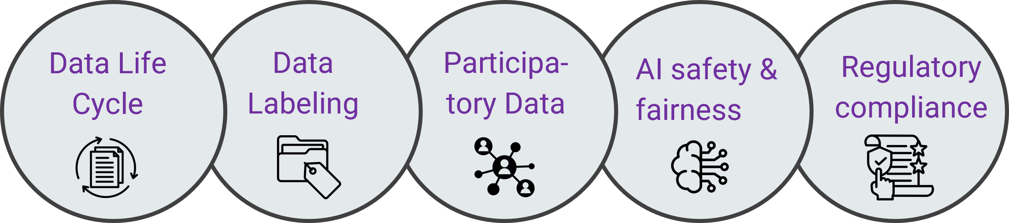
Data Life Cycle
Data Labeling
Participa-tory Data
AI safety & fairness
Regulatory compliance

